Slide 1
Unit-1 Data analytics

Slide 2
Contents
Data Definitions and Analysis Techniques –
Elements Variables and Data categorization-
Levels of Measurement- Data management and indexing-
Statistical learning, Descriptive Statistics
Basic Analysis Techniques
Data analysis techniques (Regression analysis, Classification techniques, Clustering)

Slide 3
What is Data Science?
Data science is the study of data to extract meaningful insights.
It is a multidisciplinary approach that combines principles and practices from the fields of mathematics, statistics, artificial intelligence, and computer engineering to analyze large amounts of data.
This analysis helps data scientists to ask and answer questions like what happened, why it happened, what will happen, and what can be done with the results.
Data science is important because it combines tools, methods, and technology to generate meaning from data.
Modern organizations are inundated with data; there is a proliferation of devices that can automatically collect and store information.
Online systems and payment portals capture more data in the fields of e-commerce, medicine, finance, and every other aspect of human life. We have text, audio, video, and image data available in vast quantities.

Slide 4
What is Data Science?
While the term data science is not new, the meanings and connotations have changed over time. The word first appeared in the ’60s as an alternative name for statistics. In the late ’90s, computer science professionals formalized the term.
A proposed definition for data science saw it as a separate field with three aspects: data design, collection, and analysis. It still took another decade for the term to be used outside of academia.
Artificial intelligence and machine learning innovations have made data processing faster and more efficient. Industry demand has created an ecosystem of courses, degrees, and job positions within the field of data science.
Because of the cross-functional skillset and expertise required, data science shows strong projected growth over the coming decades.

Slide 5
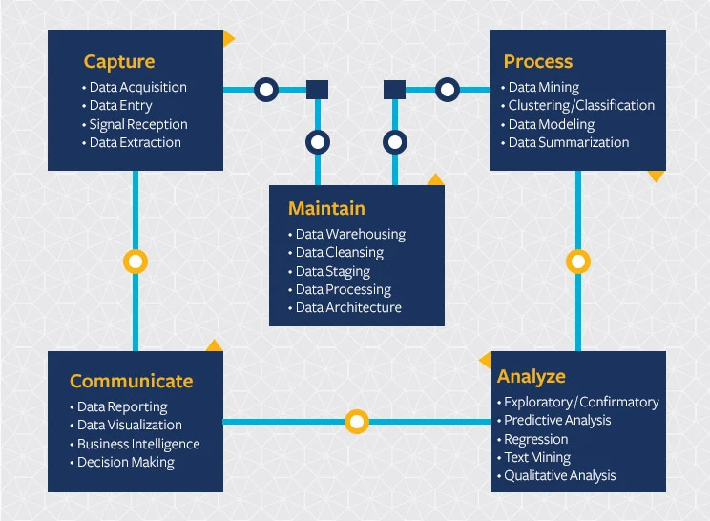
The Data Science Life Cycle

Slide 6
What is data science used for?
Data science is used to study data in four main ways:
1. Descriptive analysis
Descriptive analysis examines data to gain insights into what happened or what is happening in the data environment. It is characterized by data visualizations such as pie charts, bar charts, line graphs, tables, or generated narratives. For example, a flight booking service may record data like the number of tickets booked each day. Descriptive analysis will reveal booking spikes, booking slumps, and high-performing months for this service.
2. Diagnostic analysis
Diagnostic analysis is a deep-dive or detailed data examination to understand why something happened. It is characterized by techniques such as drill-down, data discovery, data mining, and correlations. Multiple data operations and transformations may be performed on a given data set to discover unique patterns in each of these techniques.

Slide 7
What is data science used for?
3. Predictive analysis
Predictive analysis uses historical data to make accurate forecasts about data patterns that may occur in the future. It is characterized by techniques such as machine learning, forecasting, pattern matching, and predictive modeling.For example, the flight service team might use data science to predict flight booking patterns for the coming year at the start of each year. The computer program or algorithm may look at past data and predict booking spikes for certain destinations in May. Having anticipated their customer’s future travel requirements, the company could start targeted advertising for those cities from February.
4. Prescriptive analysis
Prescriptive analytics takes predictive data to the next level. It not only predicts what is likely to happen but also suggests an optimum response to that outcome. It can analyze the potential implications of different choices and recommend the best course of action. It uses graph analysis, simulation, complex event processing, neural networks, and recommendation engines from machine learning.

Slide 8
What is the data science process?
A business problem typically initiates the data science process. A data scientist will work with business stakeholders to understand what business needs. Once the problem has been defined, the data scientist may solve it using the OSEMN data science process:
O – Obtain data
Data can be pre-existing, newly acquired, or a data repository downloadable from the internet. Data scientists can extract data from internal or external databases, company CRM software, web server logs, social media or purchase it from trusted third-party sources.
S – Scrub data
Data scrubbing, or data cleaning, is the process of standardizing the data according to a predetermined format. It includes handling missing data, fixing data errors, and removing any data outliers. Some examples of data scrubbing are:·
Changing all date values to a common standard format.·
Fixing spelling mistakes or additional spaces.·
Fixing mathematical inaccuracies or removing commas from large numbers.

Slide 9
What is the data science process?
E – Explore data
Data exploration is preliminary data analysis that is used for planning further data modeling strategies. Data scientists gain an initial understanding of the data using descriptive statistics and data visualization tools. Then they explore the data to identify interesting patterns that can be studied or actioned.
M – Model data
Software and machine learning algorithms are used to gain deeper insights, predict outcomes, and prescribe the best course of action. Machine learning techniques like association, classification, and clustering are applied to the training data set. The model might be tested against predetermined test data to assess result accuracy. The data model can be fine-tuned many times to improve result outcomes.
N – Interpret results
Data scientists work together with analysts and businesses to convert data insights into action. They make diagrams, graphs, and charts to represent trends and predictions. Data summarization helps stakeholders understand and implement results effectively.

Slide 10
Task-1
Data science in health care
Transforming e-commerce with data science
Weather prediction

Slide 11
Datafication
Datafication is the transformation of social action into online quantified data, thus allowing for real-time tracking and predictive analysis.
It is about taking previously invisible process/activity and turning it into data, that can be monitored, tracked, analysed and optimised. Latest technologies enabled lots of new ways of ‘datify’ our daily and basic activities.
Datafication is a technological trend turning many aspects of our lives into computerized data using processes to transform organizations into data-driven enterprises by converting this information into new forms of value.
Datafication refers to the fact that daily interactions of living things can be rendered into a data format and put to social use.

Slide 12
Datafication: Examples
Let’s say social platforms, Facebook or Instagram, for example, collect and monitor data information of our friendships to market products and services to us and surveillance services to agencies which in turn changes our behaviour; promotions that we daily see on the socials are also the result of the monitored data. In this model, data is used to redefine how content is created by datafication being used to inform content rather than recommendation systems.
However, there are other industries where datafication process is actively used:
Insurance: Data used to update risk profile development and business models.
Banking: Data used to establish trustworthiness and likelihood of a person paying back a loan.
Human resources: Data used to identify e.g. employees risk-taking profiles.
Hiring and recruitment: Data used to replace personality tests.
Social science research: Datafication replaces sampling techniques and restructures the manner in which social science research is performed.

Slide 13
Datafication vs. Digitization
“Datafication is not the same as digitization, which takes analog content—books, films, photographs—and converts it into digital information, a sequence of ones and zeros that computers can read. Datafication is a far broader activity: taking all aspects of life and turning them into data format.Once we datafy things, we can transform their purpose and turn the information into new forms of value.”
Datafication is more about the process of collecting, storing, and managing customer data from real-world actions, while digitization is the process of converting chosen media into computer-ready format.

Slide 14
Current landscape of perspectives
We have massive amounts of data about many aspects of our lives, and, simultaneously, an abundance of inexpensive computing power. Shopping, communicating, reading news, listening to music, searching for information, expressing our opinions—all this is being tracked online.
What people might not know is that the “datafication” of our offline behavior has started as well, mirroring the online data collection revolution. Put the two together, and there’s a lot to learn about our behavior and, by extension, who we are as a species.
It’s not just Internet data, though—it’s finance, the medical industry, pharmaceuticals, bioinformatics, social welfare, government, education, retail, and the list goes on. There is a growing influence of data in most sectors and most industries.
In some cases, the amount of data collected might be enough to be considered “big” (more on this in the next chapter); in other cases, it’s not.

Slide 15
Current landscape of perspectives
It’s not only the massiveness that makes all this new data interesting but the data itself, often in real time, becomes the building blocks of data products.
On the Internet, Amazon recommendation systems, friend recommendations on Facebook, film and music recommendations, and so on. In finance, credit ratings, trading algorithms, and models. In education, this is starting to mean dynamic personalized learning and assessments coming out of places like Coursera and Khan Academy. In government, this means policies based on data.
We’re witnessing the beginning of a massive, culturally saturated feedback loop where our behavior changes the product and the product changes our behavior. Technology makes this possible: infrastructure for large-scale data processing, increased memory, and bandwidth, as well as a cultural acceptance of technology in the fabric of our lives. This wasn’t true a decade ago.
Considering the impact of this feedback loop, we should start thinking seriously about how it’s being conducted, along with the ethical and technical responsibilities for the people responsible for the process.

Slide 16
Current landscape of perspectives
“Data science, as it’s practiced, is a blend of Red-Bull-fueled hacking and espresso-inspired statistics.” Metamarket CEO Mike Driscoll’s [2010]
Statisticians are the ones who make sense of the data deluge occurring in science, engineering, and medicine; that statistics provides methods for data analysis in all fields, from art history to zoology; that it is exciting to be a Statistician in the 21st century because of the many challenges brought about by the data explosion in all of these fields.
DJ Patil and Jeff Hammerbacher—then at LinkedIn and Facebook, respectively—coined the term “data scientist” in 2008. So that is when “data scientist” emerged as a job title. (Wikipedia finally gained an entry on data science in 2012.)

Slide 17
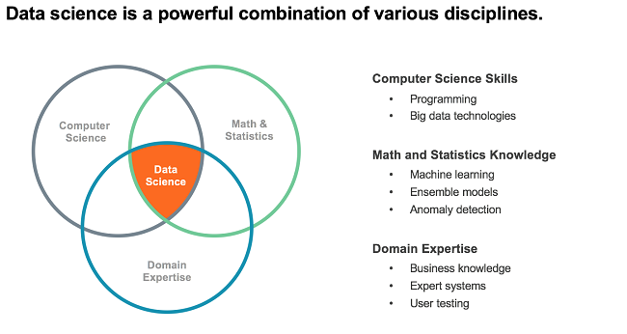
Current landscape of perspectives

Slide 18
Task
Skill set needed to become data scientist/analyst/Engineer?

Slide 19
What is Big Data?
No standard definition! here is from Wikipedia:
Big data is a term for data sets that are so large or complex that traditional data processing applications are inadequate.
Challenges include analysis, capture, data curation, search, sharing, storage, transfer, visualization, querying, updating and information privacy.
Analysis of data sets can find new correlations to "spot business trends, prevent diseases, combat crime and so on."

Slide 20


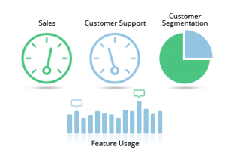
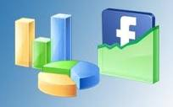







Who is generating Big Data?
Social
User Tracking & Engagement
Homeland Security
eCommerce
Financial Services
Real Time Search

Slide 21
What is Big Data?
The total amount of data created, captured, copied, and consumed globally increases rapidly, reaching 64.2 zettabytes in 2020.
It’s not easy to measure the total volume of data stored electronically, but an estimate is that over the next five years up to 2025, global data creation is projected to grow to more than 180 zettabytes.
Consider the following:
The New York Stock Exchange generates about 4-5 terabytes of data per day.
Facebook hosts more than 240 billion photos, growing at 7 petabytes per month.
Ancestry.com, the genealogy site, stores around 10 petabytes of data.
The Internet Archive stores around 18.5 petabytes of data.

Slide 22
Data Storage and Analysis
Although the storage capacities of hard drives have increased massively over the years, access speeds—the rate at which data can be read from drives have not kept up.
The size, speed, and complexity of big data necessitates the use specialist of software which in turn relies on significant processing power and storage capabilities. While costly, embracing big data analytics enables organizations to derive powerful insights and gain a competitive edge.
By 2029, the value of the big data analytics market is expected to reach over 655 billion U.S. dollars, up from around
15 billion U.S. dollars in 2019.
68 billion U.S. dollars by 2025
655 billion U.S. dollars by 2029

Slide 23
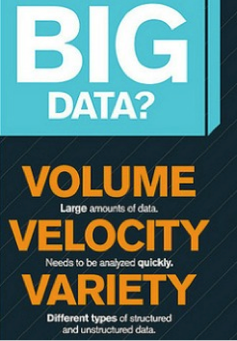

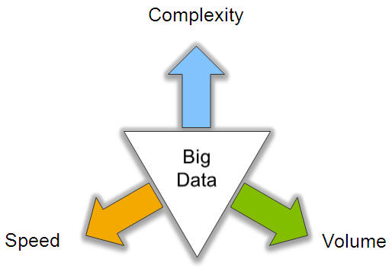
Big Data Characteristics: 3V
Notes:
Enterprise resource planning
Customer relationship management

Slide 24
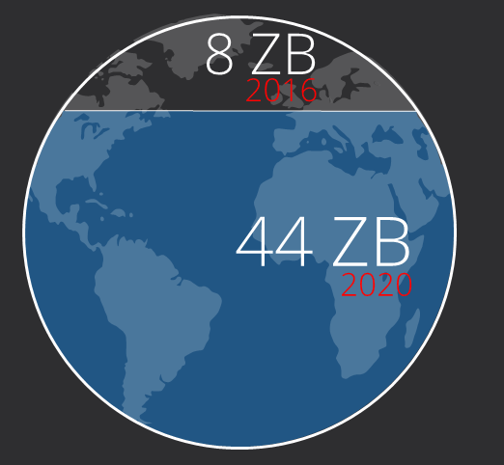

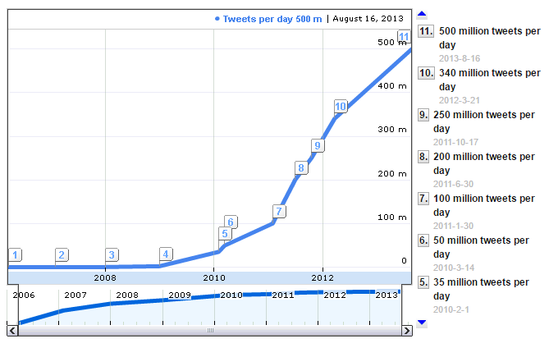
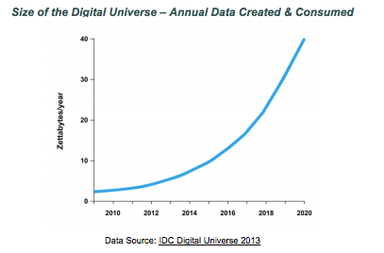
Volume (Scale)
Data Volume
Growth 40% per year
From 8 zettabytes (2016) to 44zb (2020)
Data volume is increasing exponentially
Exponential increase in collected/generated data

Slide 25








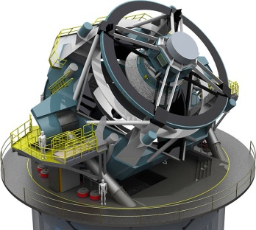


How much data?
Processes 20 PB a day (2008)
Crawls 20B web pages a day (2012)
Search index is 100+ PB (5/2014)
Bigtable serves 2+ EB, 600M QPS (5/2014)
400B pages, 10+ PB (2/2014)
Hadoop: 365 PB, 330K nodes (6/2014)
Hadoop: 10K nodes, 150K cores, 150 PB (4/2014)
150 PB on 50k+ servers running 15k apps (6/2011)
300 PB data in Hive + 600 TB/day (4/2014)
LHC: ~15 PB a year
S3: 2T objects, 1.1M request/second (4/2013)
LSST: 6-10 PB a year (~2020)
640K ought to be enough for anybody.
SKA: 0.3 – 1.5 EB per year (~2020)

Slide 26
Variety (Complexity)
Different Types:
Relational Data (Tables/Transaction/Legacy Data)
Text Data (Web)
Semi-structured Data (XML)
Graph Data
Social Network, Semantic Web (RDF), …
Streaming Data
You can only scan the data once
A single application can be generating/collecting many types of data
Different Sources：
Movie reviews from IMDB and Rotten Tomatoes
Product reviews from different provider websites
To extract knowledge➔ all these types of data need to linked together

Slide 27
















A Single View to the Customer
Social Media
Banking
Finance
Gaming
Our
Known
History
Customer
Entertain
Purchase

Slide 28




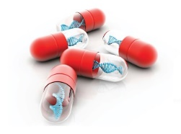


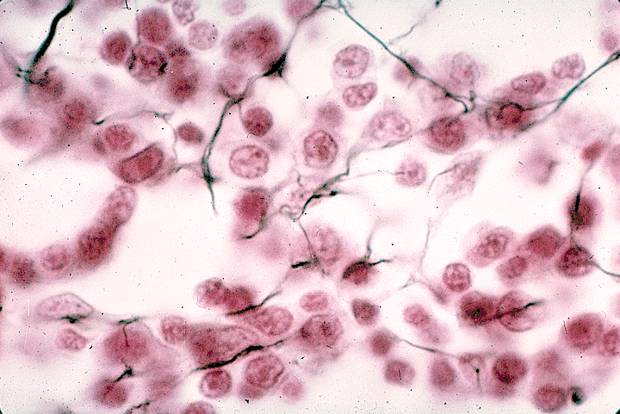
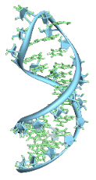






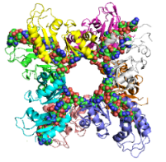

A Global View of Linked Big Data
diagnosis
prescription
doctors
drug
patient
target
“Ebola”
mutation
tissue
gene
protein
Diversified social network
Heterogeneous information network

Slide 29
Velocity (Speed)
Data is begin generated fast and need to be processed fast
Online Data Analytics
Late decisions ➔ missing opportunities
Examples
E-Promotions: Based on your current location, your purchase history, what you like ➔ send promotions right now for store next to you
Healthcare monitoring: sensors monitoring your activities and body ➔ any abnormal measurements require immediate reaction
Disaster management and response

Slide 30
Real-Time Analytics/Decision Requirement
Product
Recommendations
that are Relevant
& Compelling
Learning why Customers
Switch to competitors
and their offers; in
time to Counter
Influence
Behavior
Friend Invitations
to join a
Game or Activity
that expands
business
Improving the
Marketing
Effectiveness of a
Promotion while it
is still in Play
Customer
Preventing Fraud
as it is Occurring
& preventing more
proactively

Slide 31
Extended Big Data Characteristics: 6V
Volume: In a big data environment, the amounts of data collected and processed are much larger than those stored in typical relational databases.
Variety: Big data consists of a rich variety of data types.
Velocity: Big data arrives to the organization at high speeds and from multiple sources simultaneously.
Veracity: Data quality issues are particularly challenging in a big data context.
Visibility/Visualization: After big data being processed, we need a way of presenting the data in a manner that’s readable and accessible.
Value: Ultimately, big data is meaningless if it does not provide value toward some meaningful goal.

Slide 32
Veracity (Quality & Trust)
Data = quantity + quality
When we talk about big data, we typically mean its quantity:
What capacity of a system provides to cope with the sheer size of the data?
Is a query feasible on big data within our available resources?
How can we make our queries tractable on big data?
. . .
Can we trust the answers to our queries?
Dirty data routinely lead to misleading financial reports, strategic business planning decision ⇒ loss of revenue, credibility and customers, disastrous consequences
The study of data quality is as important as data quantity.

Slide 33
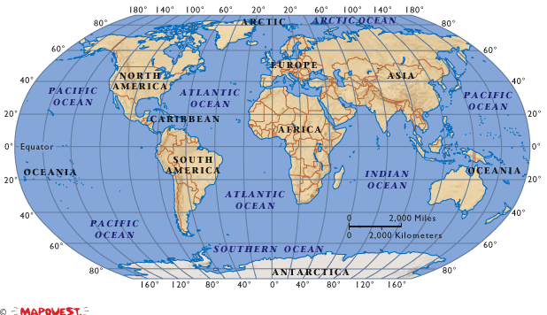
Data in real-life is often dirty
81 million National Insurance numbers but only 60 million eligible citizens
98000 deaths each year, caused by errors in medical data
500,000 dead people retain active Medicare cards

Slide 34
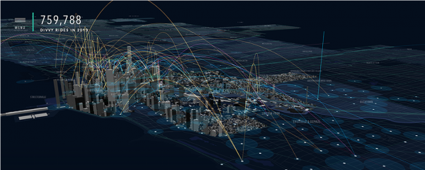
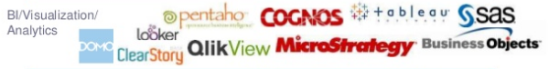
Visibility/Visualization
Visible to the process of big data management
Big Data – visibility = Black Hole?
Big data visualization tools:
A visualization of Divvy bike rides across Chicago

Slide 35
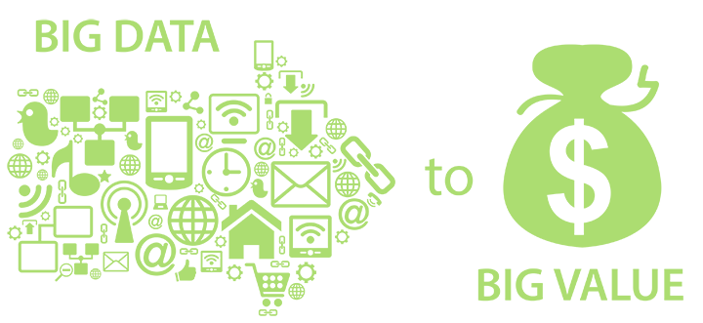
Value
Big data is meaningless if it does not provide value toward some meaningful goal

Slide 36
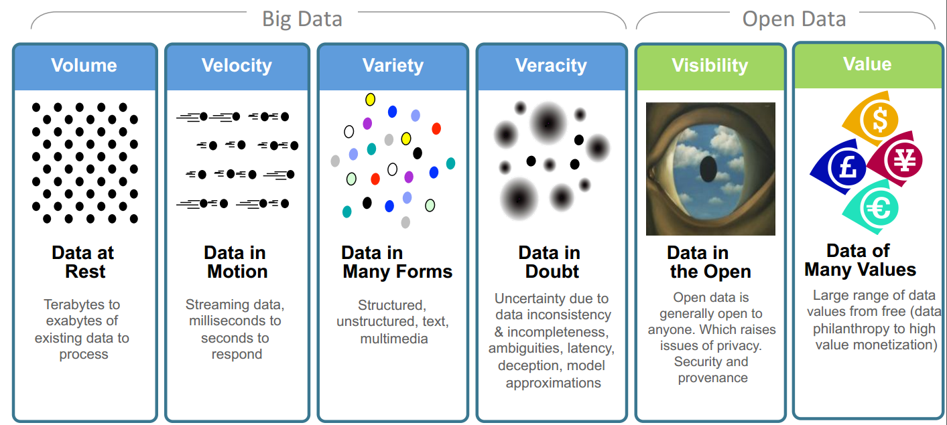
Big Data: 6V in Summary
Transforming Energy and Utilities through Big Data & Analytics. By Anders Quitzau@IBM

Slide 37
Other V’s
Variability
Variability refers to data whose meaning is constantly changing. This is particularly the case when gathering data relies on language processing.
Viscosity
This term is sometimes used to describe the latency or lag time in the data relative to the event being described. We found that this is just as easily understood as an element of Velocity.
Virality
Defined by some users as the rate at which the data spreads; how often it is picked up and repeated by other users or events.
Volatility
Big data volatility refers to how long is data valid and how long should it be stored. You need to determine at what point is data no longer relevant to the current analysis.
More V’s in the future …

Slide 38
Big Data Overview
Several industries have led the way in developing their ability to gather and exploit data:
Credit card companies monitor every purchase their customers make and can identify fraudulent purchases with a high degree of accuracy using rules derived by processing billions of transactions.
Mobile phone companies analyze subscribers’ calling patterns to determine, for example, whether a caller’s frequent contacts are on a rival network. If that rival network is offering an attractive promotion that might cause the subscriber to defect, the mobile phone company can proactively offer the subscriber an incentive to remain in her contract.
For companies such as LinkedIn and Facebook, data itself is their primary product. The valuations of these companies are heavily derived from the data they gather and host, which contains more and more intrinsic value as the data grows.

Slide 39
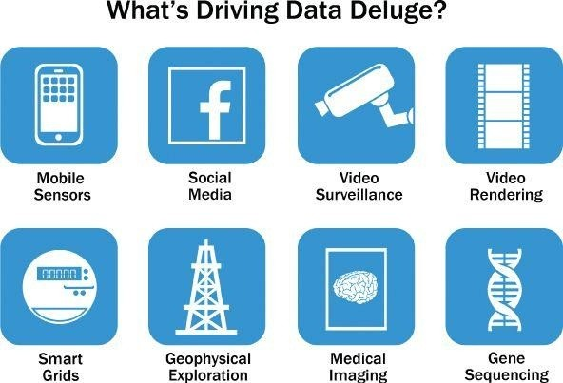
Big Data Overview
McKinsey’s definition of Big Data implies that organizations will need new data architectures and analytic sandboxes, new tools, new analytical methods, and an integration of multiple skills into the new role of the data scientist

Slide 40
Big Data Overview
Social media and genetic sequencing are among the fastest-growing sources of Big Data and examples of untraditional sources of data being used for analysis.
For example, in 2012 Facebook users posted 700 status updates per second worldwide, which can be leveraged to deduce latent interests or political views of users and show relevant ads. For instance, an update in which a woman changes her relationship status from “single” to “engaged” would trigger ads on bridal dresses, wedding planning, or name-changing services.
Facebook can also construct social graphs to analyze which users are connected to each other as an interconnected network. In March 2013, Facebook released a new feature called “Graph Search,” enabling users and developers to search social graphs for people with similar interests, hobbies, and shared locations.

Slide 41
Big Data Overview
Another example comes from genomics. Genetic sequencing and human genome mapping provide a detailed understanding of genetic makeup and lineage. The health care industry is looking toward these advances to help predict which illnesses a person is likely to get in his lifetime and take steps to avoid these maladies or reduce their impact through the use of personalized medicine and treatment.
Such tests also highlight typical responses to different medications and pharmaceutical drugs, heightening risk awareness of specific drug treatments.

Slide 42
Mathematics for Data Science
Mathematics for Machine Learning and Data Science Specialization (Coursera)
https://www.coursera.org/specializations/mathematics-for-machine-learning-and-data-science#courses

Slide 43
Statistics
Statistics is a method of interpreting, analyzing and summarizing the data.
Statistical analysis is meant to collect and study the information available in large quantities
For example, the collection and interpretation of data about a nation like its economy and population, military, literacy, etc.
Statistics have majorly categorized into two types:
Descriptive statistics
Inferential statistics

Slide 44
Descriptive Statistics
In descriptive statistics, the data is summarized through the given observations.
The summarization is done from a sample of population using parameters such as the mean or standard deviation.
Descriptive statistics is a way to organize, represent and describe a collection of data using tables, graphs, and summary measures. For example, the collection of people in a city using the internet or using Television.
Descriptive statistics are also categorized into four different categories:
Measure of frequency - frequency measurement displays the number of times a particular data occurs
Measure of dispersion - Range, Variance, Standard Deviation are measures of dispersion. It identifies the spread of data
Measure of central tendency - Central tendencies are the mean, median and mode of the data
Measure of position - the measure of position describes the percentile and quartile ranks.

Slide 45
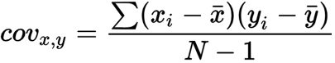
Covariance

Slide 46
The marks scored by 4 students in Maths and Physics are given below
Students | Maths | Physics
A | 85 | 80
B | 70 | 40
C | 95 | 75
D | 50 | 70
Calculate Covariance Matrix from the above data.

Slide 47
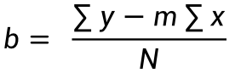
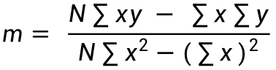
X (Midterm exam) Y (Final exam)
72 84
50 63
81 77
74 78
94 90
86 75
59 49
83 79
65 77
33 52
88 74
81 90
$$m= \frac{N\sum{xy − \sum{x}}\sum{y}}{N\sum{x^{2}}−{(\sum{x})}^{2}}$$
$$b= \frac{\sum{y}−m\sum{x}}{N}$$
Predict the final exam grade of a student who received an 86 on the midterm exam.

Slide 49
Inferential statistics
Inferential statistics is a branch of statistics that involves using data from a sample to make inferences about a larger population. It is concerned with making predictions, generalizations, and conclusions about a population based on the analysis of a sample of data.
Inferential statistics help to draw conclusions about the population while descriptive statistics summarizes the features of the data set.
Inferential statistics encompasses two primary categories –
hypothesis testing and
regression analysis.
It is crucial for samples used in inferential statistics to be an accurate representation of the entire population.

Slide 50
Statistical methods for evaluation:
Hypothesis Testing
Difference of Means
Wilcoxon Rank-Sum Test
Type I and Type II
Errors
power and sample size
ANOVA

Slide 51
Hypothesis Testing
Statistical hypothesis is an assumption made about the data of the population collected for any experiment. Hypothesis testing is also known as “T Testing”.
It is not mandatory for this assumption to be true every time.
In order to validate a hypothesis, it will consider the entire population into account. However, this is not possible practically. Thus, to validate a hypothesis, it will use random samples from a population.
On the basis of the result from testing over the sample data, it either selects or rejects the hypothesis.
As an example, you may make the assumption that the longer it takes to develop a product, the more successful it will be, resulting in higher sales than ever before. Before implementing longer work hours to develop a product, hypothesis testing ensures there’s an actual connection between the two.

Slide 52
Hypothesis Testing
Statistical Hypothesis Testing can be categorized into two types as below:
Null Hypothesis – Hypothesis testing is carried out in order to test the validity of a claim or assumption that is made about the larger population. This claim that involves attributes to the trial is known as the Null Hypothesis. The null hypothesis testing is denoted by H0.
Alternative Hypothesis – An alternative hypothesis would be considered valid if the null hypothesis is fallacious. The evidence that is present in the trial is basically the data and the statistical computations that accompany it. The alternative hypothesis testing is denoted by H1or Ha.

Slide 53
Hypothesis Testing
Hypothesis testing is conducted in the following manner:
State the Hypotheses – Stating the null and alternative hypotheses.
Formulate an Analysis Plan – The formulation of an analysis plan is a crucial step in this stage.
Analyze Sample Data – Calculation and interpretation of the test statistic, as described in the analysis plan.
Interpret Results – Application of the decision rule described in the analysis plan.
Hypothesis testing ultimately uses a p-value to weigh the strength of the evidence or in other words what the data are about the population. The p-value ranges between 0 and 1. It can be interpreted in the following way:
A small p-value (typically ≤ 0.05) indicates strong evidence against the null hypothesis, so you reject it.
A large p-value (> 0.05) indicates weak evidence against the null hypothesis, so you fail to reject it.
A p-value very close to the cutoff (0.05) is considered to be marginal and could go either way.

Slide 54
Hypothesis Testing
The two types of error that can occur from the hypothesis testing:
Type I Error – Type I error occurs we rejects a null hypothesis when it is true. The term significance level is used to express the probability of Type I error while testing the hypothesis. The significance level is represented by the symbol α (alpha).
Type II Error – Accepting a false null hypothesis H0 is referred to as the Type II error. The term power of the test is used to express the probability of Type II error while testing hypothesis. The power of the test is represented by the symbol β (beta).

Slide 55
“Does drinking a cup of coffee before an exam improve students' test performance?”
Draw null and alternative hypothesis for given question. Also, If the p-value obtained after hypothesis testing is 0.03 (at Significance level = 0.05) then what will be the conclusion?

Slide 56
One Sample T-Testing
One sample T-Testing approach collects a huge amount of data and tests it on random samples. To perform T-Test normally distributed data is required.
This test is used to test the mean of the sample with the population. For example, the height of persons living in an area is different or identical to other persons living in other areas.
help("t.test")
# Defining sample vector
x <- rnorm(100)
# One Sample T-Test
t.test(x, mu = 5)

Slide 57
Two Sample T-Testing
In two sample T-Testing, the sample vectors are compared
# Defining sample vector
x <- rnorm(100)
y <- rnorm(100)
# Two Sample T-Test
t.test(x, y)

Slide 58
Difference of Means
Reference:
https://stats.libretexts.org/Courses/Luther_College/Psyc_350%3ABehavioral_Statistics_(Toussaint)/08%3A_Tests_of_Means/8.03%3A_Difference_between_Two_Means

Slide 59
Wilcoxon Test
The Student’s t-test requires that the distributions follow a normal distribution or if the sample size is large enough (usually n≥30, thanks to the central limit theorem)
Wilcoxon test compare two groups when the normality assumption is violated
The Wilcoxon test is a non-parametric test, meaning that it does not rely on data belonging to any particular parametric family of probability distributions.
There are actually two versions of the Wilcoxon test:
Wilcoxon rank sum test (also referred as The Mann-Withney-Wilcoxon test or Mann-Whitney U test) is performed when the samples are independent (this test is the non-parametric equivalent to the Student’s t-test for independent samples).
The Wilcoxon signed-rank test (also sometimes referred as Wilcoxon test for paired samples) is performed when the samples are paired/dependent (this test is the non-parametric equivalent to the Student’s t-test for paired samples).

Slide 60
Wilcoxon rank sum test
Problem: Apply Wilcoxon rank sum test on the given data of following 24 students (12 boys and 12 girls)
Girls | 19 | 18 | 9 | 17 | 8 | 7 | 16 | 19 | 20 | 9 | 11 | 18
Boys | 16 | 5 | 15 | 2 | 14 | 15 | 4 | 7 | 15 | 6 | 7 | 14
The null and alternative hypothesis of the Wilcoxon test are as follows:
H0 : the 2 groups are equal in terms of the variable of interest
H1: the 2 groups are different in terms of the variable of interest
Applied to our research question, we have:
H0 : grades of girls and boys are equal
H1 : grades of girls and boys are different

Slide 61
Wilcoxon rank sum test
data <- data.frame(Gender = as.factor(c(rep("Girl", 12), rep("Boy", 12))),
Grade = c(19, 18, 9, 17, 8, 7, 16, 19, 20, 9, 11, 18,16, 5, 15, 2,
14, 15, 4, 7, 15, 6, 7, 14))
library(ggplot2)
ggplot(data) + aes(x = Gender, y = Grade) +
geom_boxplot(fill = "#0c4c8a") + theme_minimal()
hist(subset(data, Gender == "Girl")$Grade,
main = "Grades for girls",
xlab = "Grades" )
hist(subset(data, Gender == "Boy")$Grade,
main = "Grades for boys",
xlab = "Grades" )
test <- wilcox.test(data$Grade ~ data$Gender)
test

Slide 62
Wilcoxon rank sum test
We obtain the following test statistic, the p-value and a reminder of the hypothesis tested.
Wilcoxon rank sum test with continuity correction
data: data$Grade by data$Gender
W = 31.5, p-value = 0.02056
alternative hypothesis: true location shift is not equal to 0
The p-value is 0.02056. Therefore, at the 5% significance level, we reject the null hypothesis and we conclude that grades are significantly different between girls and boys.

Slide 63
Correlation and Regression
Relation between variables where changes in some variables may “explain” or possibly “cause” changes in other variables.
Explanatory variables are termed the independent variables and the variables to be explained are termed the dependent variables.
Regression model estimates the nature of the relationship between the independent and dependent variables.
Change in dependent variables that results from changes in independent variables, ie. size of the relationship.
Strength of the relationship.
Statistical significance of the relationship.

Slide 64
Examples
Dependent variable is retail price of gasoline – independent variable is the price of crude oil.
Dependent variable is employment income – independent variables might be hours of work, education, occupation, sex, age, region, years of experience, unionization status, etc.
Price of a product and quantity produced or sold:
Quantity sold affected by price. Dependent variable is quantity of product sold – independent variable is price.
Price affected by quantity offered for sale. Dependent variable is price – independent variable is quantity sold.

Slide 66
Bivariate and multivariate models
100% Y = 0.2*x1+0.15* x2+0.5*x3+0.15*x4
Bivariate or simple regression model
(Education) x y (Income)
(Education) x₁
(Sex) x₂
(Experience) x₃
(Age) x₄
Multivariate or multiple regression model
y (Income)
Model with simultaneous relationship
Price of wheat
Quantity of wheat produced

Slide 67
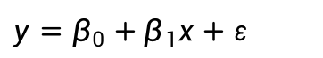
Bivariate or simple linear regression
x is the independent variable
y is the dependent variable
The regression model is
The model has two variables, the independent or explanatory variable, x, and the dependent variable y, the variable whose variation is to be explained.
The relationship between x and y is a linear or straight line relationship.
Two parameters to estimate – the slope of the line β1 and the y-intercept β0 (where the line crosses the vertical axis).
ε is the unexplained, random, or error component. Much more on this later.
$$y=β_{0}+β_{1}x+ε$$

Slide 68
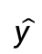
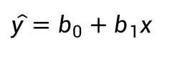
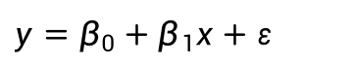
Regression line
The regression model is
Data about x and y are obtained from a sample.
From the sample of values of x and y, estimates b0 of β0 and b1 of β1 are obtained using the least squares or another method.
The resulting estimate of the model is
The symbol is termed “y hat” and refers to the predicted values of the dependent variable y that are associated with values of x, given the linear model.
$$y=β_{0}+β_{1}x+ε$$
$$\hat{y}=b_{0}+b_{1}x$$
$$\hat{y}$$

Slide 69
Uses of regression
Amount of change in a dependent variable that results from changes in the independent variable(s) – can be used to estimate elasticities, returns on investment in human capital, etc.
Attempt to determine causes of phenomena.
Prediction and forecasting of sales, economic growth, etc.
Support or negate theoretical model.
Modify and improve theoretical models and explanations of phenomena.

Slide 71
R² = 0.311
Significance = 0.0031

Slide 72
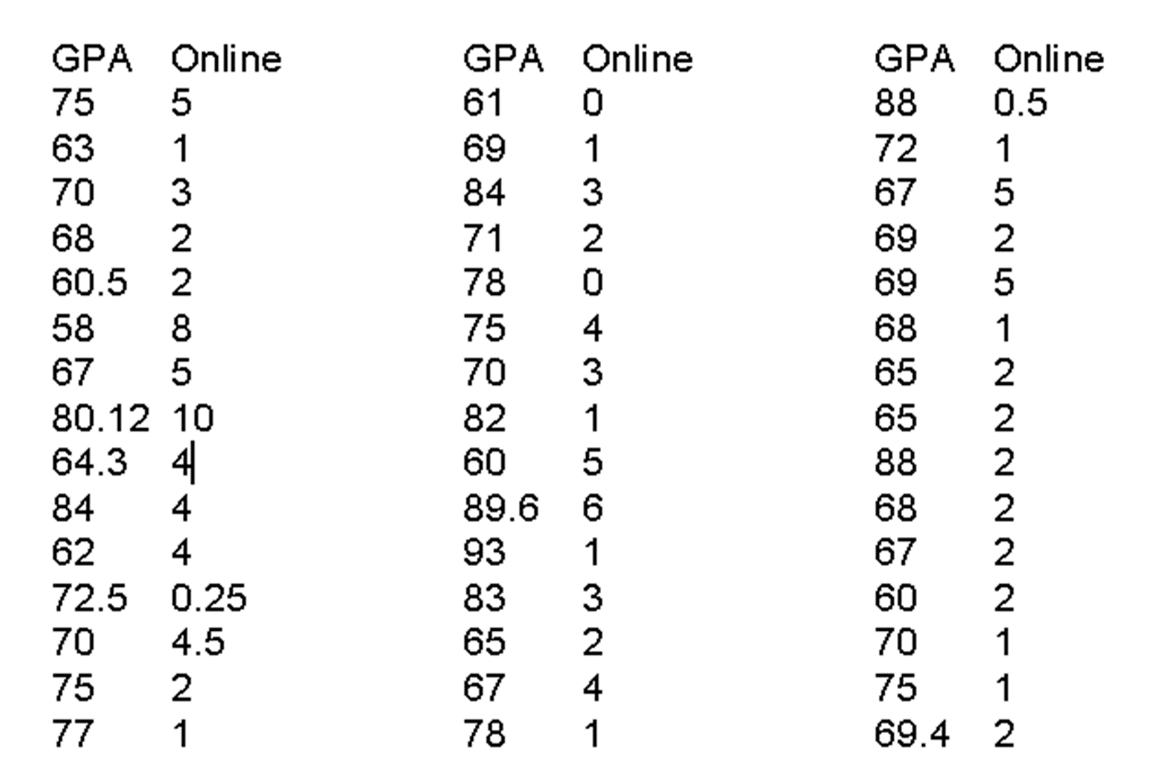

Slide 74
Outliers
Rare, extreme values may distort the outcome.
Could be an error.
Could be a very important observation.
Outlier: more than 3 standard deviations from the mean.

Slide 76
Classification
Labelled Data
Logistic Regression
ANN
SVM etc

Slide 77
Clustering
Cluster: A collection of data objects
similar (or related) to one another within the same group
dissimilar (or unrelated) to the objects in other groups
Cluster analysis (or clustering, data segmentation, …)
Finding similarities between data according to the characteristics found in the data and grouping similar data objects into clusters
Unsupervised learning: no predefined classes (i.e., learning by observations vs. learning by examples: supervised)
Typical applications
As a stand-alone tool to get insight into data distribution
As a preprocessing step for other algorithms

Slide 78
Clustering: Applications
Biology: taxonomy of living things: kingdom, phylum, class, order, family, genus and species
Information retrieval: document clustering
Land use: Identification of areas of similar land use in an earth observation database
Marketing: Help marketers discover distinct groups in their customer bases, and then use this knowledge to develop targeted marketing programs
City-planning: Identifying groups of houses according to their house type, value, and geographical location
Earth-quake studies: Observed earth quake epicenters should be clustered along continent faults
Climate: understanding earth climate, find patterns of atmospheric and ocean
Economic Science: market research

Slide 79
Clustering as a Preprocessing Tool (Utility)
Summarization:
Preprocessing for regression, PCA, classification, and association analysis
Compression:
Image processing: vector quantization
Finding K-nearest Neighbors
Localizing search to one or a small number of clusters
Outlier detection
Outliers are often viewed as those “far away” from any cluster

Slide 80
Quality: What Is Good Clustering?
A good clustering method will produce high quality clusters
high intra-class similarity: cohesive within clusters
low inter-class similarity: distinctive between clusters
The quality of a clustering method depends on
the similarity measure used by the method
its implementation, and
Its ability to discover some or all of the hidden patterns

Slide 81
Measure the Quality of Clustering
Dissimilarity/Similarity metric
Similarity is expressed in terms of a distance function, typically metric: d(i, j)
The definitions of distance functions are usually rather different for interval-scaled, boolean, categorical, ordinal ratio, and vector variables
Weights should be associated with different variables based on applications and data semantics
Quality of clustering:
There is usually a separate “quality” function that measures the “goodness” of a cluster.
It is hard to define “similar enough” or “good enough”
The answer is typically highly subjective

Slide 82
Considerations for Cluster Analysis
Partitioning criteria
Single level vs. hierarchical partitioning (often, multi-level hierarchical partitioning is desirable)
Separation of clusters
Exclusive (e.g., one customer belongs to only one region) vs. non-exclusive (e.g., one document may belong to more than one class)
Similarity measure
Distance-based (e.g., Euclidian, road network, vector) vs. connectivity-based (e.g., density or contiguity)
Clustering space
Full space (often when low dimensional) vs. subspaces (often in high-dimensional clustering)

Slide 83
Requirements and Challenges
Scalability
Clustering all the data instead of only on samples
Ability to deal with different types of attributes
Numerical, binary, categorical, ordinal, linked, and mixture of these
Constraint-based clustering
User may give inputs on constraints
Use domain knowledge to determine input parameters
Interpretability and usability
Others
Discovery of clusters with arbitrary shape
Ability to deal with noisy data
Incremental clustering and insensitivity to input order
High dimensionality

Slide 84
Major Clustering Approaches
Partitioning approach:
Construct various partitions and then evaluate them by some criterion, e.g., minimizing the sum of square errors
Typical methods: k-means, k-medoids, CLARANS
Hierarchical approach:
Create a hierarchical decomposition of the set of data (or objects) using some criterion
Typical methods: Diana, Agnes, BIRCH, CAMELEON
Density-based approach:
Based on connectivity and density functions
Typical methods: DBSACN, OPTICS, DenClue
Grid-based approach:
based on a multiple-level granularity structure
Typical methods: STING, WaveCluster, CLIQUE

Slide 85
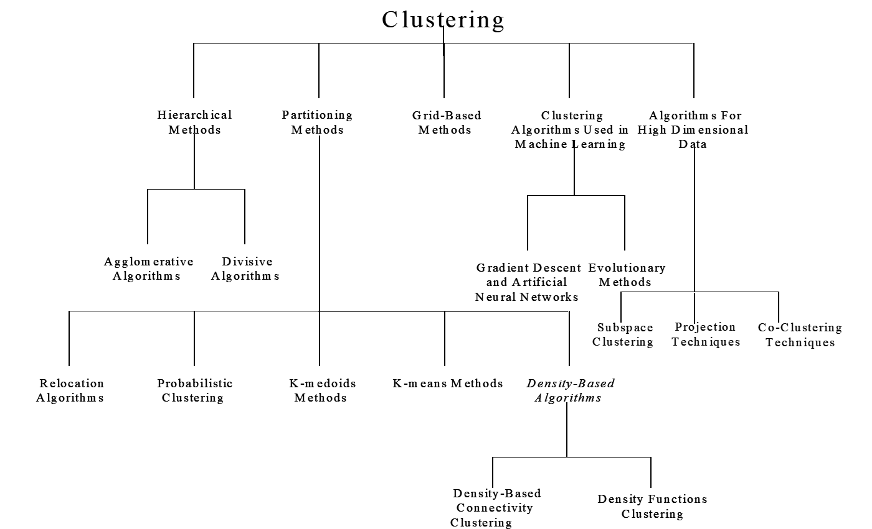

Slide 86
Happy Learning

